Slide 1
Introduction to food processing: Where does our food come from?
Developed by Dr. Keren Dalyot and Yael Rozenblum, Faculty of Education in Science and Technology, Technion.

Slide 2
Opening Activity: What do you know about what you eat?
What did you eat for breakfast?
Write each component on a separate post-it/piece of paper
Come and put the notes in the column you think they belong.

Slide 3
Definitions of Food Processing
Any of a variety of operations by which raw foodstuffs are made suitable for consumption, cooking, or storage.
(Source: Britannica)
Transforming ingredients to products.
(Source: International Agency for Research on Cancer - European Prospective Investigation into Cancer and Nutrition)
Turning fresh foods to products, by industry. (Source: The NOVA classification system)
Any (deliberate) change to a food
(since origin).
(Source: International Food
Information Council)

Slide 4
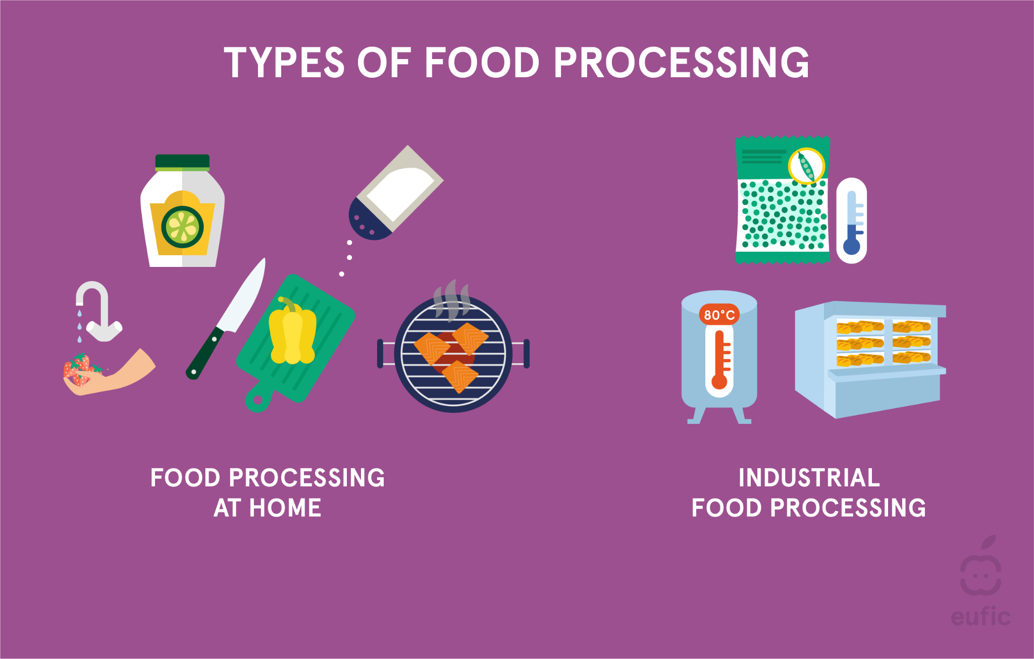
Types and Classification of Food Processing
Source: ABC of Food Processing @ EUFIC

Slide 5
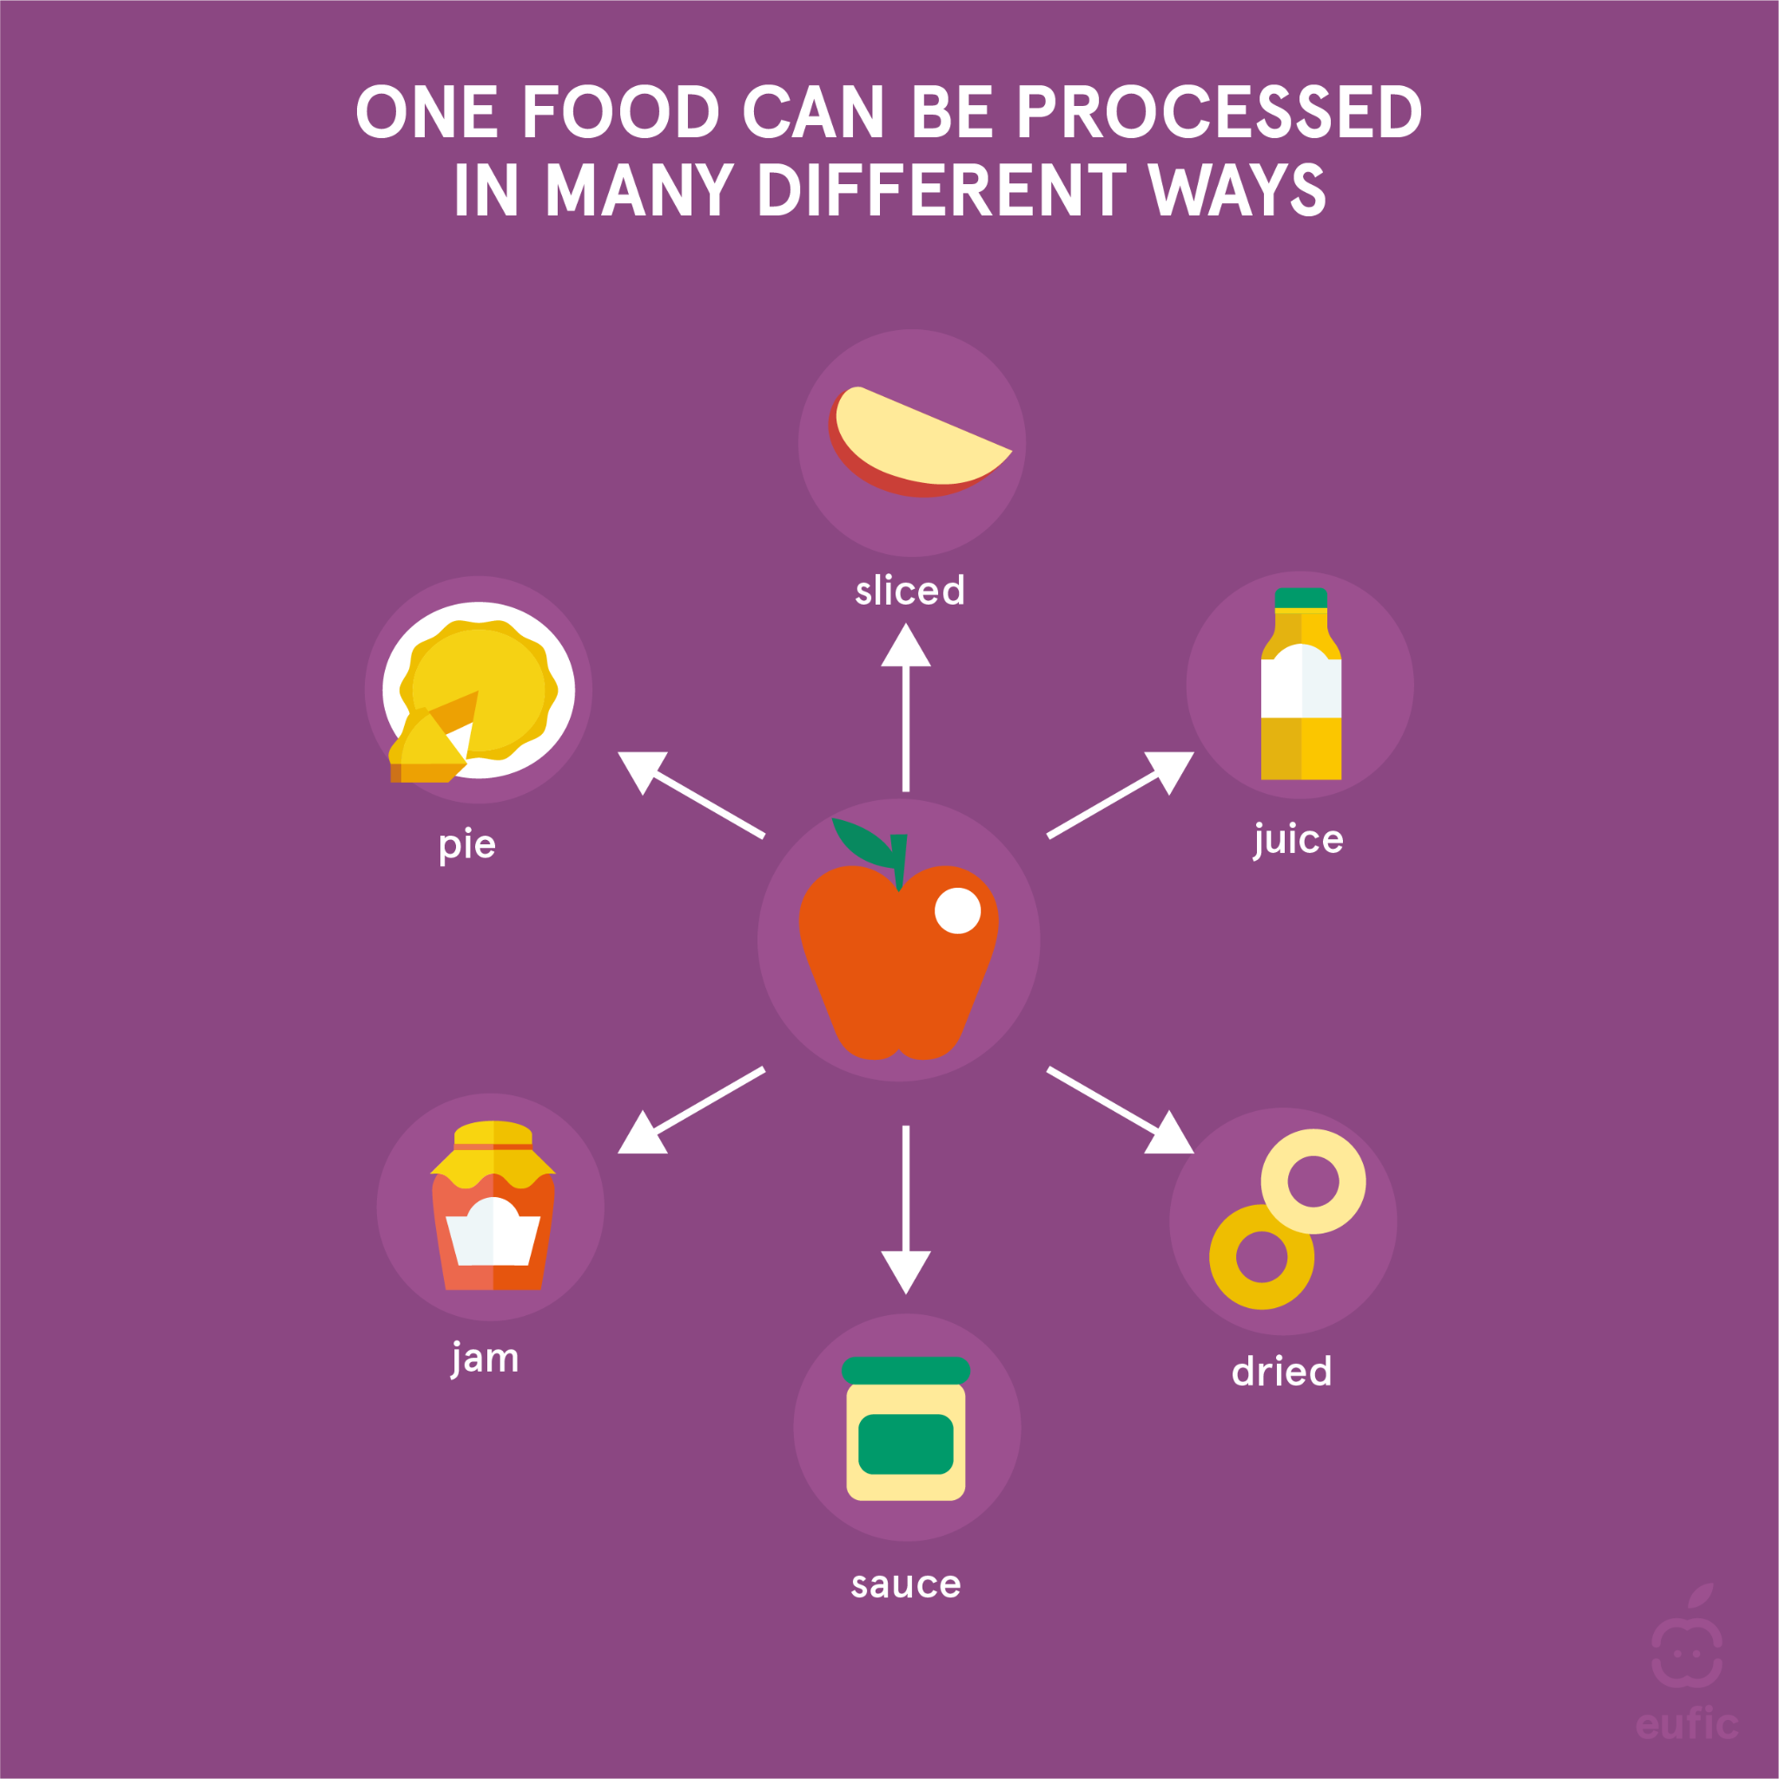
Types and Classification of Food Processing
Source: ABC of Food Processing @ EUFIC

Slide 6
Classification of Food Processing Levels
There are several worldwide suggestion for this categorisation, this is the one offered by the International Food Information Council*:
1. Minimally processed
2. Processed for preservation
3. Mixtures of combined ingredients
3.1 Packaged mixes, jarred sauce
3.2 Mixtures, home prepared
4.“Ready-to-eat” foods
4.1 Packaged ready-to-eat foods
4.2 Mixtures, store prepared
5. Prepared foods/meals
* https://ific.org/ - An American based nonprofit with a mission to effectively communicate science-based information about health, nutrition, food safety and agriculture.

Slide 7
Some History
Food processing has existed since prehistoric times: man used fire 250,000 years ago which later led to what we know as the cooking process.
Historically cooking helps in two main ways: improving the taste and even more importantly it improves the level of digestion and helps in disinfection from bacteria.
More complex food processing appeared during antiquity and the Middle Ages and were manifested in baking bread, making cheeses, smoked meats and even beverages such as wine.

Slide 8
Food processing in modern times
The Industrial Revolution (18th - 19th century): the beginning of mass and industrialised food production.
This included the creation of the pasteurisation process and food preservation.
In the first half of the 20th century: following the two world wars and the changes that took place around the world, food processing processes intensified in order to provide the large and poor population with accessible and cheap food.

Slide 9

Why Do We Need Processed Foods?

Slide 10
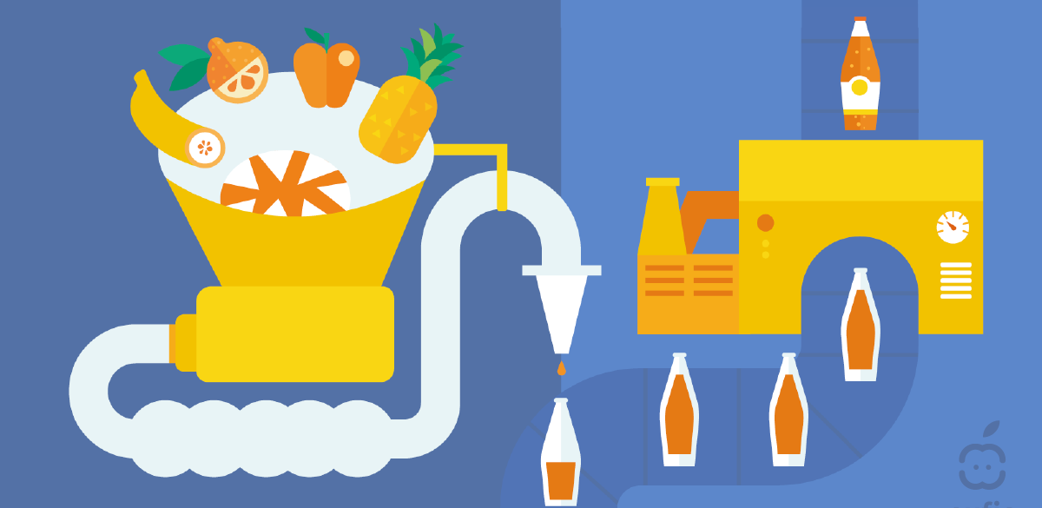
Why Do We Need Processed Foods?
Makes food edible
Safety, shelf life, and preservation
Nutritional quality
Convenience
Price
Source: Why do we process food? @ EUFIC

Slide 11
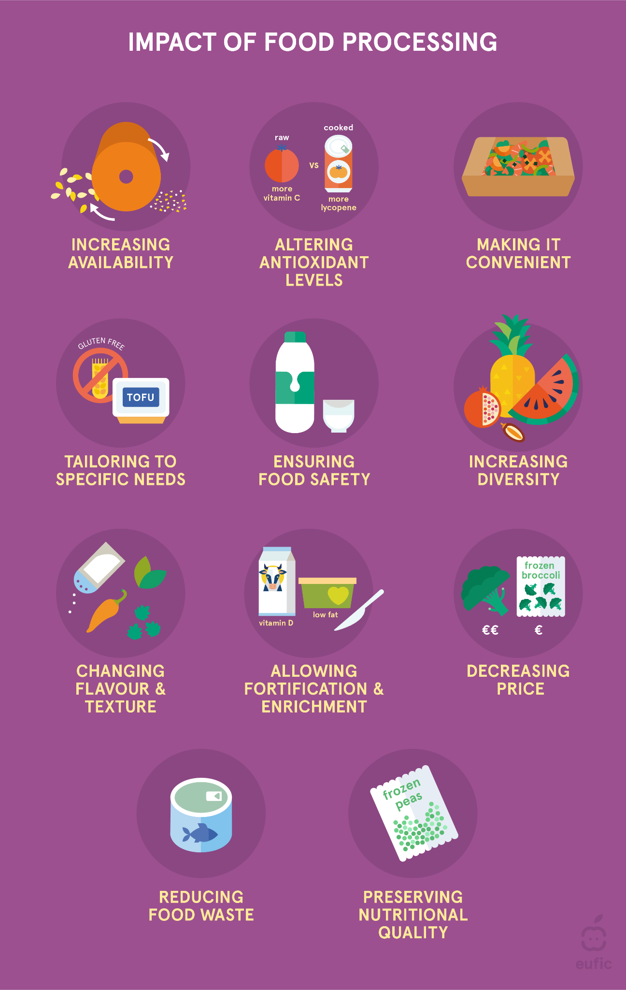
Impact of Food Processing
Source: ABC of Food Processing @ EUFIC

Slide 12
Ultra-Processed Foods- What Are They?
“Ultra-processed foods are formulations of ingredients, mostly of exclusive industrial use, typically created by series of industrial techniques and processes… Processes enabling the manufacture of ultra-processed foods involve several steps and different industries. It starts with the fractioning of whole foods into substances including sugars, oils and fats, proteins, starches and fibre. These substances are often obtained from a few high-yield plant foods (such as corn, wheat, soya, cane or beet)... ”
Source: https://www.fao.org/3/ca5644en/ca5644en.pdf

Slide 13
Ultra-Processed Foods- What Are They?
“Ultra-processed foods are made mostly from substances extracted from foods, such as fats, starches, added sugars, and hydrogenated fats. They may also contain additives like artificial colors and flavors or stabilisers. ”
Source: https://www.health.harvard.edu/blog/what-are-ultra-processed-foods-and-are-they-bad-for-our-health-2020010918605

Slide 14
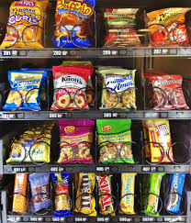
Why Do We Eat More Processed Foods Nowadays?
The colours, flavors and aromas, along with the fat, sugar and salt cause us to eat larger amounts than we really need.
Streamlining production, transportation and distribution contribute to availability and immediacy of consumption
Intensive marketing and advertising

Slide 15
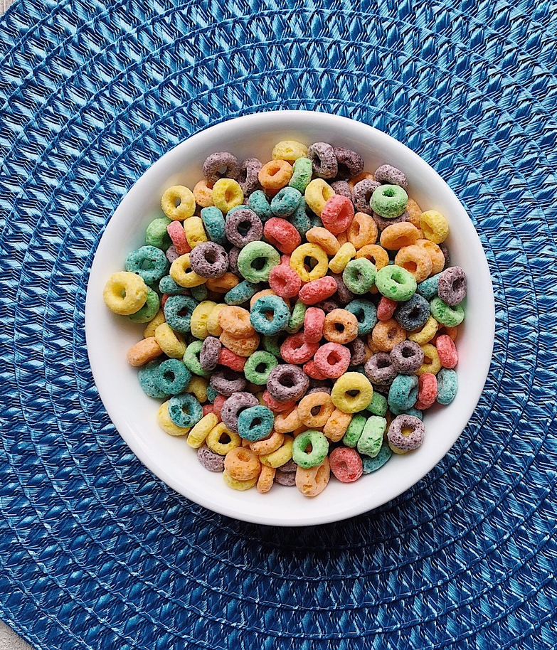
And Why is it so Bad for Us?
Research links ultra-processed foods to a number of health problems. People who eat more of the stuff are more likely to be obese, and have diabetes, heart disease, and vascular disease (that includes stroke), too.
Ultra-processed foods, (though not all of them), tend to be low in fiber and other essential nutrients. and
Eating them causes us to eat less nutritious foods
Source: Hidden Dangers of Ultra-processed Foods

Slide 16
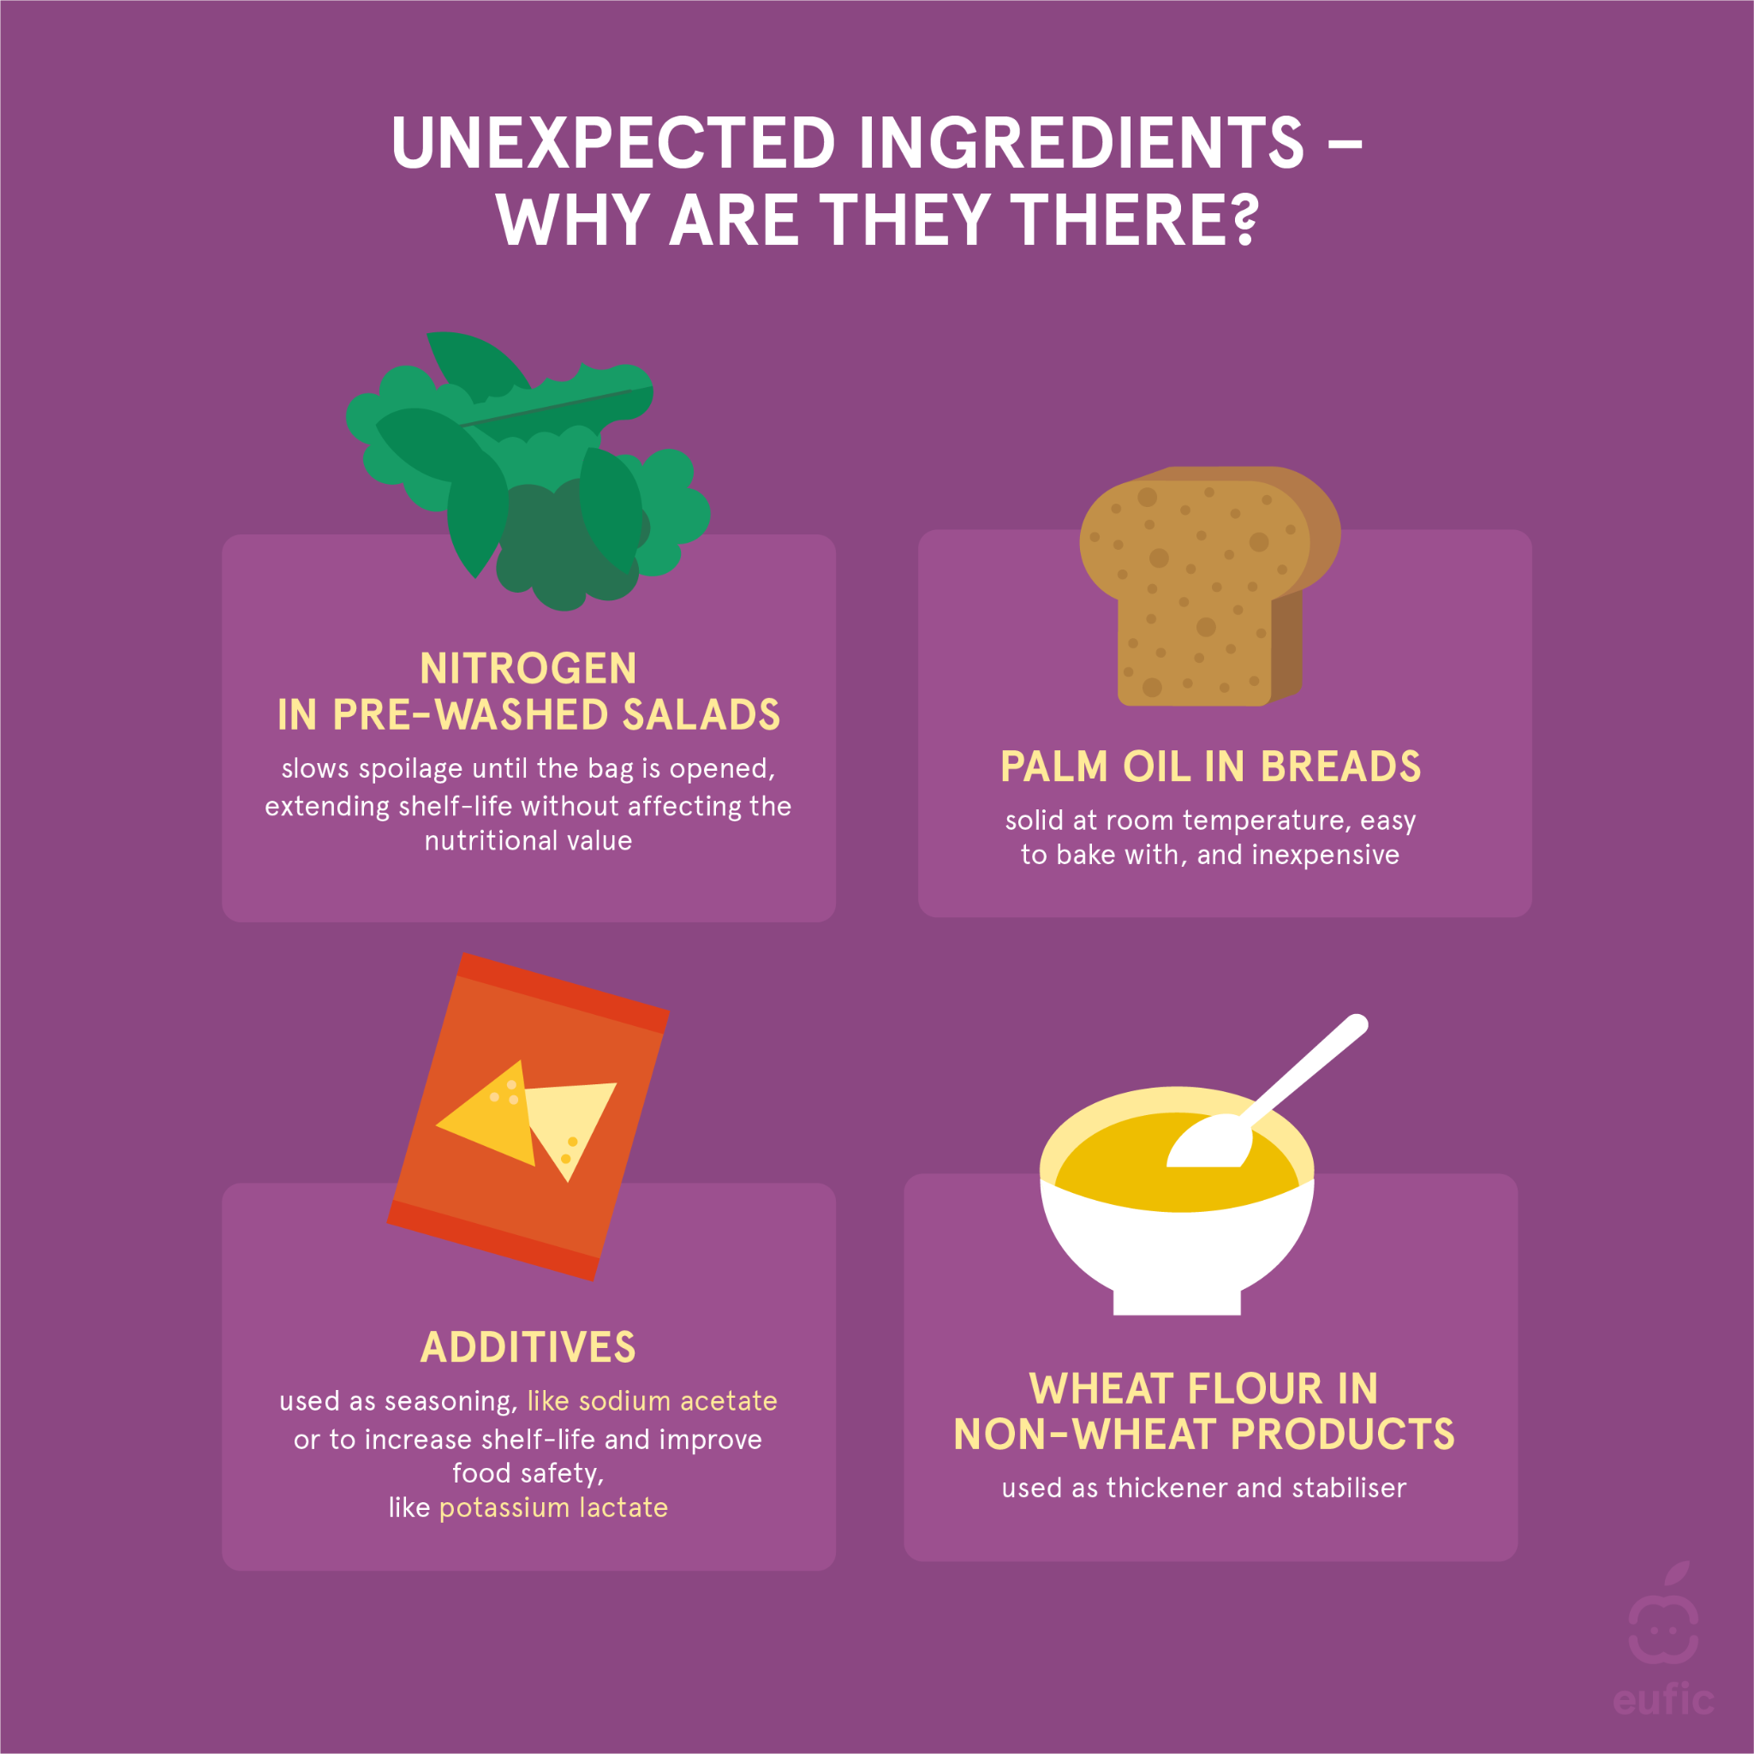
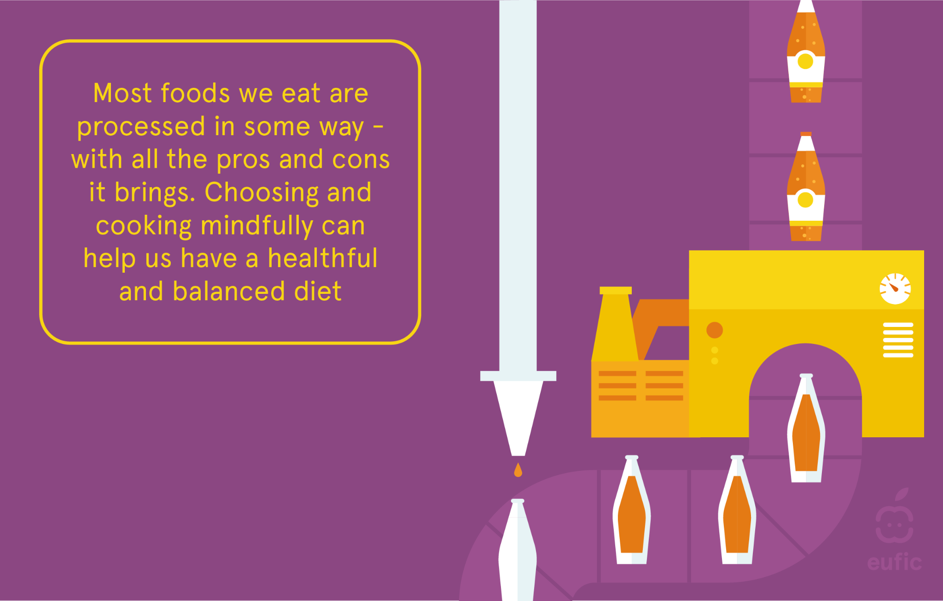
Get the Most Out of Processed Foods
Source: ABC of Food Processing @ EUFIC

Slide 17
Thank you!

